Slide 1
Robotics technology
ROS Presentation
JIRAWAT THAUEA 630631140

Slide 2
Create map
Use Gazebo application to create the map
Go to Edit ,then click Building Editor for creating wall and room. If you finish for create please save the files.
After that use Module Editor to add objects that you want in your environment ,then if you have finished please save it again.

Slide 3
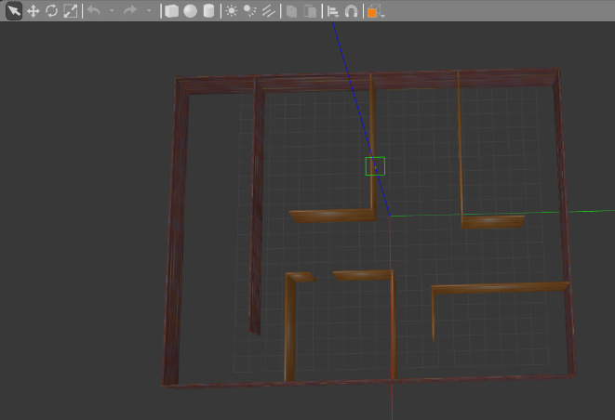
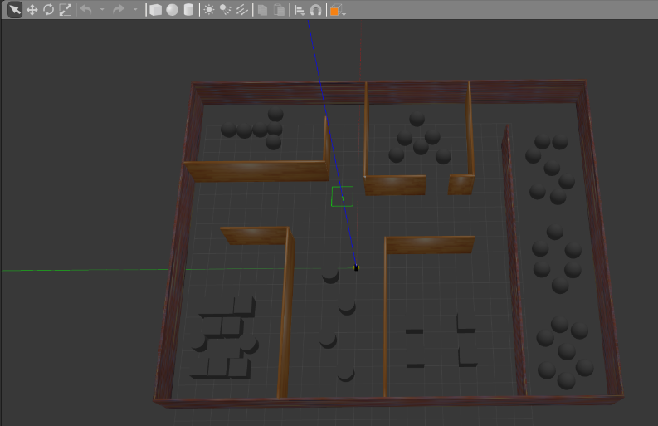
Create map

Slide 4
Scanning map
Use command in terminal from tutorial 8 for scanning the map
$ roslaunch spcbot_gazebo JameCondo.launch
$ roslaunch spcbot_description rviz.launch
$ rosrun teleop_twist_keyboard teleop_twist_keyboard.py

Slide 5
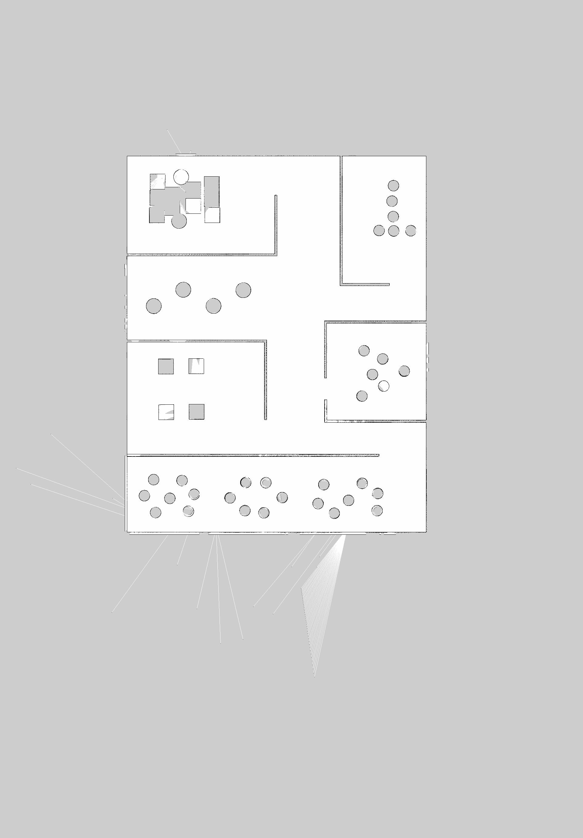
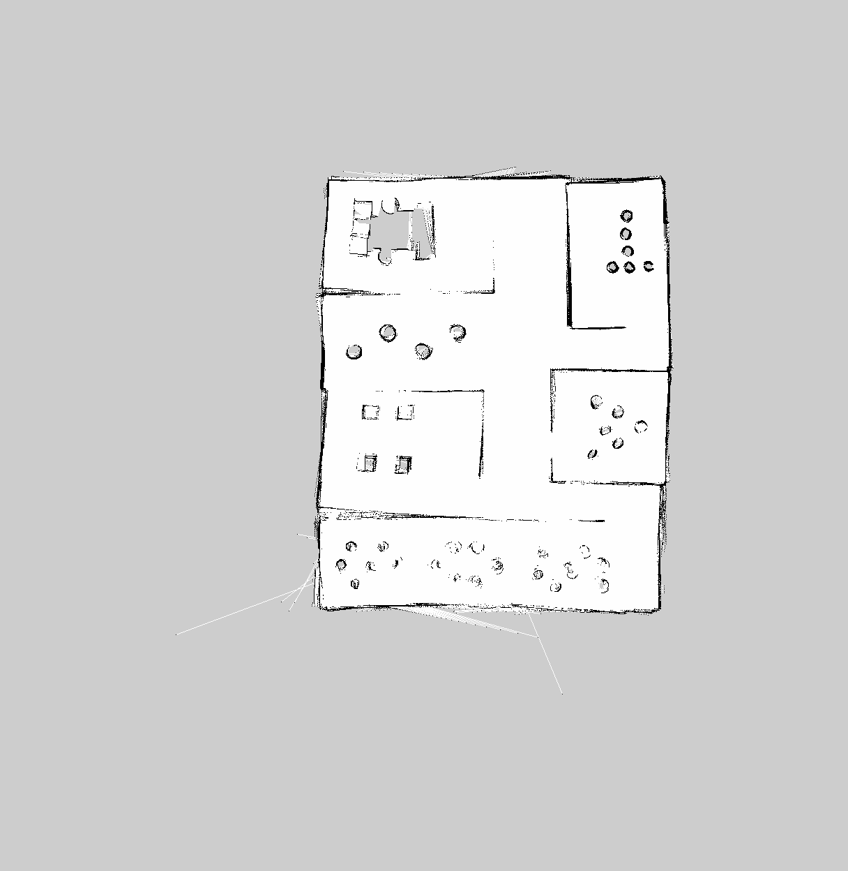

Scanning map
After that we got the map as figure 1 and figure 2
Failed Scanning
true Scanning
Figure 1
Figure 2

Slide 6
Scanning map
Use command in terminal to save scanning the map
$ rosrun map_server map_saver -f ~/map

Slide 7
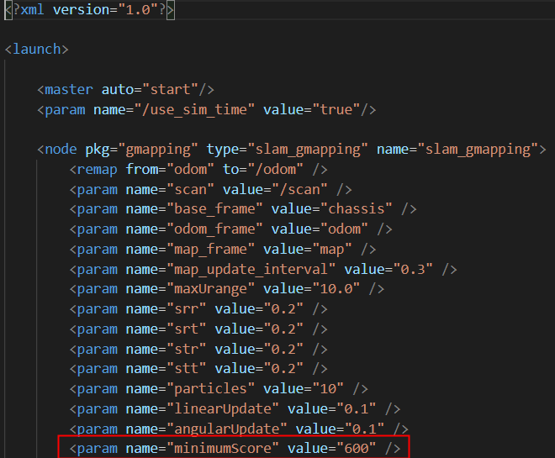
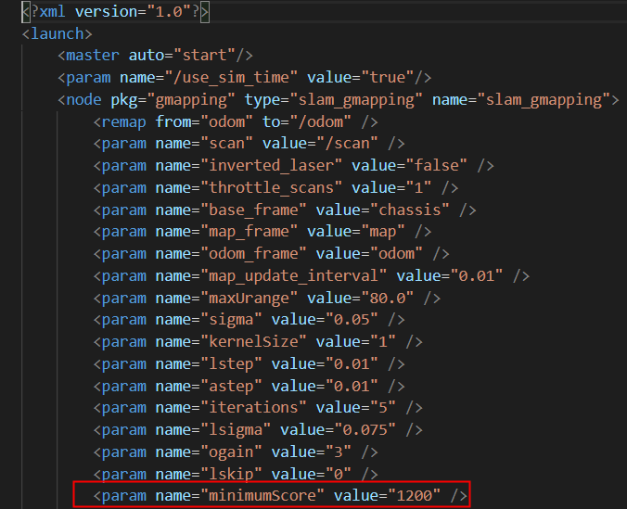
Scanning map
From previous slide make we know why the map was failed
The minimum scores should be as figure 4
Figure 3
Figure 4

Slide 8
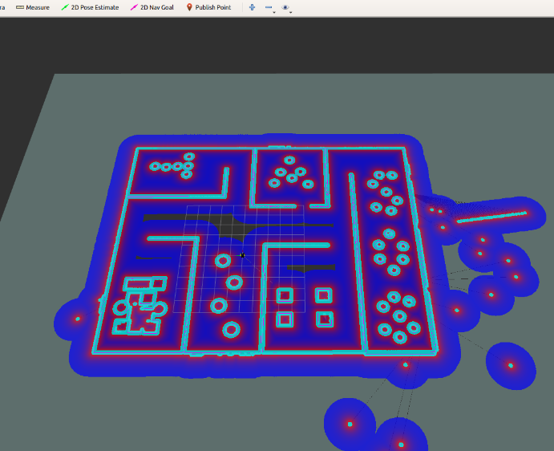
Cost map
Use command at the same way in tutorial 8 to get the cost map
$ roslaunch spcbot_gazebo JameCondo.launch
$ roslaunch spcbot_description rviz.launch
$ roslaunch spcbot_navigation spcbot_navigation.launch

Slide 9
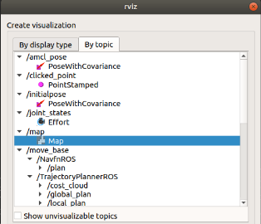
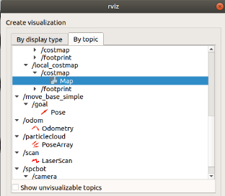
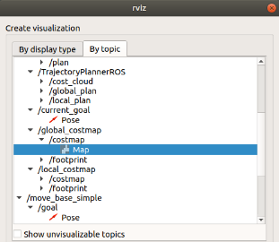
Cost map
Add map from figure 5
Add Local cost map from figure 6
Add Global cost map from figure 7
Figure 5
Figure 6
Figure 7

Slide 10
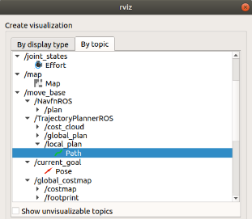
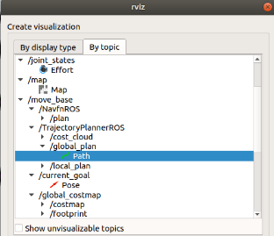
Cost map
If you want to know about movement of your spcbot ,you’ll use path.
Add Local path from figure 8
Add Global path from figure 9
Figure 8
Figure 9

Slide 11
MAke goal
Have 2 ways for make goal
1. Use Rviz to get the goal by 2D Nav Goal command
2. Coding by python3

Slide 12
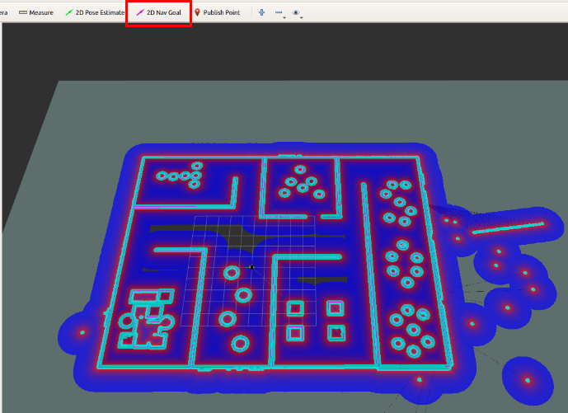
Make goal
1. Use Rviz to get the goal by 2D Nav Goal command

Slide 13
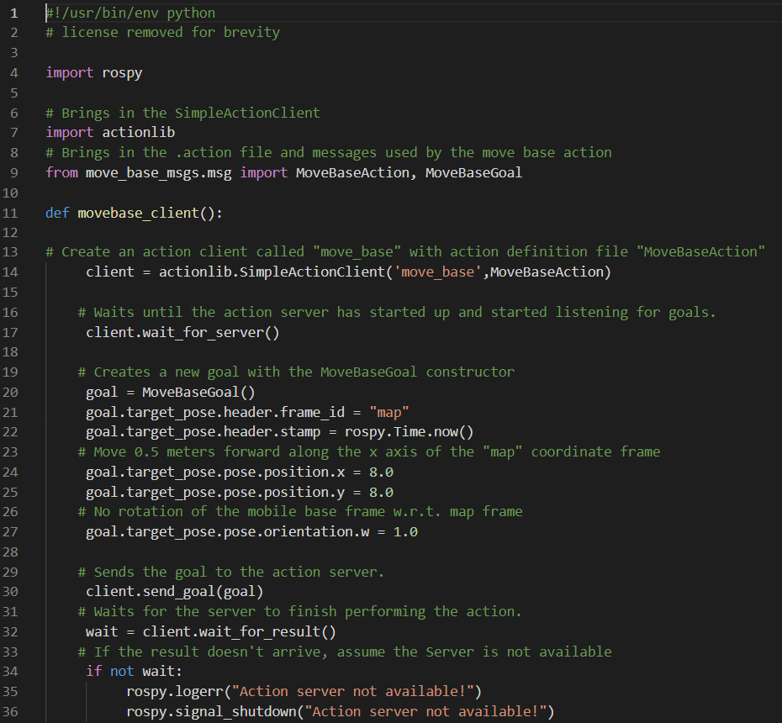
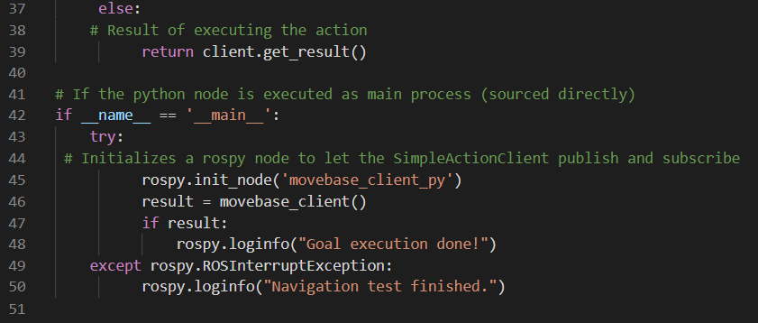
MAke goal
2. Coding by python3

